Slide 1
Success of the Early Detection Rapid Response treatment Method
A case study in Teton County, Wyoming
Notes:
Hello, My name is Mark Daluge and I am the Assistant Supervisor for the Teton County Weed and Pest District in Jackson, Wyoming. I am excited to have this opportunity to share results of a project that was initiated over 10 years ago to evaluate how prioritization, recordkeeping, and the utilization of the Early Detection Rapid Response method can be deployed successfully.

Slide 2
About Us
Special District mandated by State Statute, to implement and pursue an effective program for the control of designated and declared weeds and pests.
One of the gateway communities to Grand Teton and Yellowstone National Parks.
2021 over 5 million visits.
Notes:
The Teton County Weed and Pest District is one of 23 Districts directed by Wyoming State Statute to implement an effective program to control state designated and county declared weeds and pests. Each County in Wyoming contains a Weed and Pest District which is funded by county property tax dollars.
Teton County, is roughly 2.7 million acres in size, of which 97% is Public Land. As a gateway community to Grand Teton and Yellowstone National Parks, Jackson Hole absorbs 5 million visitors yearly. Teton County is also home to the National Elk Refuge and the Bridger Teton National Forest, a small amount of BLM land and State lands also are present. The Jackson Hole Weed Management Association, has allowed the partnership across land ownerships to implement a well coordinated invasive plant control effort.

Slide 3
Our Goal:
Implement a monitoring strategy to measure effectiveness of treatment of high priority species across jurisdictions within Teton County.
Notes:
For years, a few species were designated as high priority in Teton County and were treated and monitored yearly by various staff members. Of course, this effort was dependent on time available during the busy summer season, and records were either maintained on paper or in the sometimes-reliable database called the human brain.
In 2011, the District had a goal to implement a monitoring strategy to measure the effectiveness of treatment of high priority species across all jurisdictions including private land within Teton County.

Slide 4
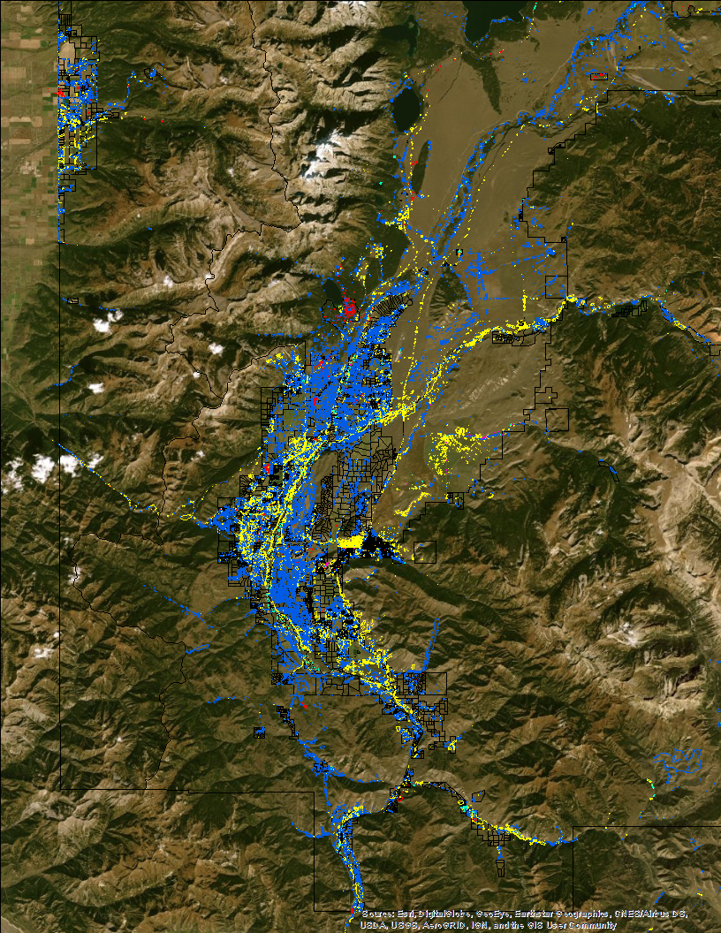
Step 1: Data
Compile species presence information
Evaluate species density, distribution, and risk
Identify trends and opportunities (clean areas?)
Ask “What is reasonable to expect”?
Notes:
In order to implement this effort, first we needed to have a good understanding of what species were present, and evaluate the density, distribution, and risk of those species.
It just so happened that a few years earlier, an extensive mapping effort took place, so we had most of the data needed…we just had to unpack it all.
During this exercise, we were able to identify trends and opportunities. Which areas tended to have species present, and which areas could we protect from invasion?
We also had to ask ourselves, what are reasonable expectations? How many locations can be visited in a summer? What density of infestations were reasonable to try to eradicate?

Slide 5
Step 2: Prioritize
Rare Infestation
Localized Infestation
1
2
3 and 4
Regional and Widespread infestations
Found in extremely low numbers in Teton County. EDRR method used to eradicate.
Found in Low numbers in Teton County. EDRR method utilized to eradicate new infestations and reduce numbers.
Established in large numbers:
Localized
County-wide
Notes:
Once we had all of our data organized, we set up a prioritization schedule which took into account many of the questions from the previous slide.
First, we looked at species that were established in large numbers county wide or were established in high numbers in specific regions of the county. Those species were then categorized as Widespread and Regional infestations, or priority 4 and 3 species respectively, Programmatically, we aim to keep these infestations from getting worse, from year to year. These are many of the species that you see along the typical vectors of travel or disturbed areas.
Next, we looked for species that were found in low numbers throughout the County, but maybe a bit higher concentrations in specific areas. These species were categorized as Localized infestations or priority 2 species. For these species we believed we could use the Early Detection Rapid Response method to eradicate new infestations and hopefully reduce known locations densities.
Finally, we were left with species that were found in extremely low numbers currently, or species that we surely didn’t want to get established via new introductions. These were categorized as Rare infestations or Priority 1 species. Eradication of these species is our number one goal.

Slide 6
Step 3: Assign Species
Rare Infestation
Identify species to monitor your effectiveness
1
Localized Infestation
2
3 and 4
Regional and Widespread infestations
Yellow hawkweed
Orange hawkweed
Scotch thistle
Saltcedar
Russian/Diffuse/ Meadow knapweed
Rush skeletonweed
Perennial pepperweed
Dyer’s woad
Common teasel
Garlic mustard
Moth mullein
Puncturevine
Purple loosestrife
Yellow flag iris
Yellow starthistle
Austrian fieldcress
Baby’s breath
Chicory
Cypress spurge
Leafy spurge
Myrtle spurge
Russian olive
Tall buttercup
Yellow chamomile
Whitetop
St. Johnswort
Plumeless thistle
Musk/Canada/Bull thistle
Spotted knapweed
Common mullein
Black henbane
Yellow toadflax
Dalmatian toadflax
Sulfur cinquefoil
Oxeye daisy
Houndstongue
Field scabious
Absinth wormwood
Hoary alyssum
Common tansy
Common burdock
Scentless chamomile
Houndstongue
Yellow/Dalmatian toadflax
Oxeye daisy
Notes:
Here is a look at how many of our species shook out after this process. As you can see, thistles, houndstongue, and other prevalent species in Teton County ended up as Priority 3 or 4’s.
Some of our less common species such as St. Johnswort, Spurge’s, and Tall buttercup landed as priority 2 species.
And that left us with rare species such as hawkweeds, saltcedar, rush skeletonweed, and moth mullein as priority 1 species. (click animation)
So, we took this list of species and decided to give our project a go.

Slide 7
Step 4: Create Database
Date | Location | Species | Observer | Status | Treatment | Rate | Info
Notes:
In order to track our data, we needed to decide what data we wanted to collect. Obviously, we wanted to know where the location was, species, and date visited.
We also decided to record who the observer was, how many plants were present, the method of treatment, the rate of herbicide if chemical control was used, and any other useful information that the observer wanted to share, like plant is growing out of a rootball or something. Later in our program we also added an option to take a photo of the infestation in order to help future observers get an idea of the characteristics of the location.

Slide 8
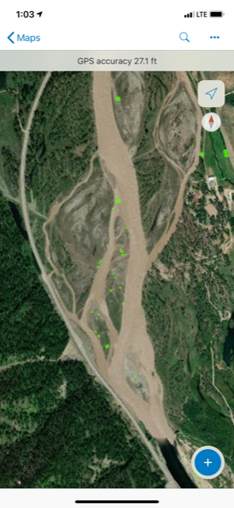
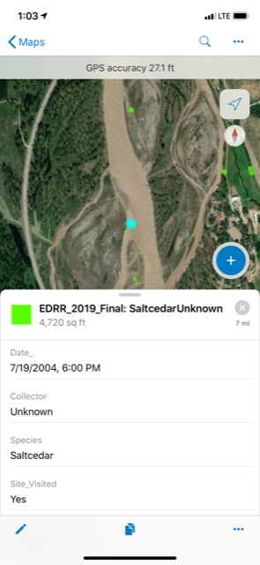
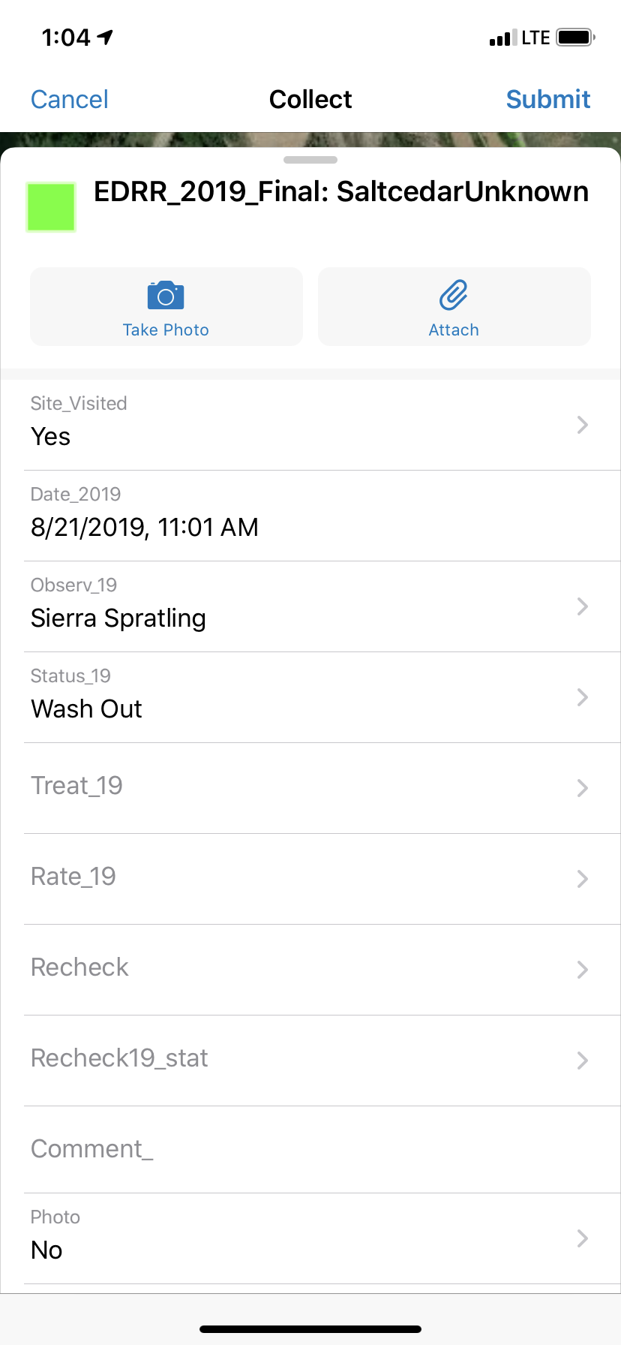
Step 5: Collect Yearly Data
Notes:
From there, we were ready to collect our data. We eventually migrated to use arconline products for this such as collector or now fieldmaps. Here you can see some of your locations on the snake river. These have all been checked, because they are green, but if a location was not checked yet that season, the points would show up in an easily viewable RED color.
So, in the photos here you can see what the observer would see as they select and enter the info for the site. It is a pretty easy, quick way to keep track of what is going on out there. And you can see the option to take a photo there on the far right snap shot towards the top.

Slide 9
Step 6: Repeat and Analyze
OBJECTID | Date_ | Collector | Species | Stat_15 | Stat_16 | Status_17 | Status_18 | Status_19 | Latitude | Recheck | Photo | GlobalID | Treat_19 | Rate_19 | Recheck19_stat | Comment_ | Site_Visited | Observ_18 | Date_18 | Shape__Area | Shape__Length
501 | 2010-08-01 0:00 | Austin Armstrong | Rush skeletonweed | NLP | NLP | NLP | NLP | NLP | 43.17774119 | No | No | {0396a906-fe20-4782-8222-3ee0488ddddf} |  |  | NLP |  | Yes | Richard Samuelson | 2018-06-07 16:07 | 4.8296E-08 | 0.0008097
537 | 2011-07-18 0:00 | Teddy Parker-Renga | Leafy spurge | NLP | NLP | 6-10 Plants | NLP | NLP | 43.43526376 |  | No | {a9df3d6d-5e9d-4eb5-9b29-7c29f6192e01} |  |  |  |  | Yes | Richard Samuelson | 2018-06-25 15:08 | 4.81837E-08 | 0.0008114
548 | 2014-09-03 0:00 | Coleton Rives | Leafy spurge | NLP | NLP | NLP | NLP | NLP | 43.45885542 |  | No | {e53eb8f8-b9ed-499a-af21-58de4478d298} |  |  |  |  | Yes | Richard Samuelson | 2018-07-12 15:43 | 1.10522E-08 | 0.0003802
558 | 2004-06-01 0:00 | Erika Edmiston | Leafy spurge | NLP | NLP | NLP | NLP | NLP | 43.4656346 |  | No | {b0b672c3-4c18-44c8-936e-6029d8d4b3f9} |  |  |  |  | Yes | Richard Samuelson | 2018-06-20 19:37 | 4.87325E-08 | 0.000814
563 | 2007-08-27 0:00 | Ronda Cauffman | Leafy spurge | NLP | NLP | NLP | NLP | 1-5 Plants | 43.46694084 |  | Yes | {b2db5e55-0e10-4442-8a78-a17940029884} | Chemical | Roundup >3% |  |  | Yes | Richard Samuelson | 2018-06-20 19:27 | 5.37029E-08 | 0.0009483
572 | 2011-06-21 0:00 | TCWP Seasonal | Leafy spurge | NLP | NLP | NLP | NLP | NLP | 43.47484675 |  | No | {8d88da24-ef6b-4ff0-8662-5249a452f045} |  |  |  |  | Yes | Richard Samuelson | 2018-06-27 13:30 | 8.03757E-08 | 0.0011729
580 | 2013-07-02 0:00 | TCWP Seasonal | Leafy spurge | NLP | NLP | NLP | NLP | NLP | 43.48995205 |  | No | {e670ac61-d448-4547-a9d2-ca5e1e6d9642} |  |  |  |  | Yes | Richard Samuelson | 2018-06-26 21:36 | 3.96367E-08 | 0.0007198
583 | 2006-06-01 0:00 | Erika Edmiston | Leafy spurge | NLP | NLP | NLP | NLP | NLP | 43.49043624 |  | No | {1df9fda5-6dc2-4ef7-aaea-1b43c16b0176} |  |  |  |  | Yes | Richard Samuelson | 2018-06-26 21:39 | 8.46544E-08 | 0.0011406
586 | 2006-07-06 0:00 | Erika Edmiston | Leafy spurge | NLP | NLP | NLP | NLP | NLP | 43.49448771 |  | No | {45325748-d3a9-4875-832e-ef5210b88737} |  |  |  |  | Yes | Richard Samuelson | 2018-05-31 16:35 | 4.44987E-07 | 0.0024439
592 | 2009-06-24 0:00 | Aaron Foster | Leafy spurge | NLP | NLP | NLP | NLP | NLP | 43.49782507 |  | No | {2be656ad-cbee-4d71-9a55-fd44aca4b069} |  |  |  |  | Yes | Richard Samuelson | 2018-06-26 21:16 | 5.37589E-07 | 0.0047782
594 | 2009-06-24 0:00 | Aaron Foster | Leafy spurge | NLP | NLP | 6-10 Plants | NLP | NLP | 43.50386365 |  | No | {6aef0cf4-9c72-4775-b4aa-ad5a7df6d873} |  |  |  |  | Yes | Richard Samuelson | 2018-07-03 16:59 | 4.87485E-08 | 0.0008142
611 | 2007-07-19 0:00 | Ronda Cauffman | Leafy spurge | NLP | NLP | NLP | NLP | 11-30 Plants | 43.52860086 | Yes | No | {f8b1ceae-33f1-4555-bc8f-c04191ce571d} | Chemical | Roundup >3% |  |  | Yes | Richard Samuelson | 2018-06-27 14:45 | 9.61295E-08 | 0.0012899
614 | 2009-08-18 0:00 | Aaron Foster | Leafy spurge | NLP | NLP | NLP | NLP | 6-10 Plants | 43.53723169 |  | Yes | {3d3aa003-7bc0-4b73-a6e1-8433fec80c50} | Chemical | Roundup >3% |  |  | Yes | Richard Samuelson | 2018-06-27 14:30 | 4.87148E-08 | 0.0008137
615 | 2003-07-02 0:00 | Unknown | Leafy spurge | NLP | NLP |  |  | NLP | 43.53753867 |  | No | {fad52104-a119-4d2a-8b9a-7a0933ff28c9} |  |  |  |  | Yes | Richard Samuelson |  | 4.87266E-08 | 0.0008139
616 | 2007-08-31 0:00 | Aaron Foster | Leafy spurge | NLP | NLP | NLP | NLP | >30 Plants | 43.54175469 | Yes | Yes | {235cdf1d-cc5c-455b-9ec7-2633b3e51309} | Chemical | Roundup >3% |  |  | Yes | Richard Samuelson | 2018-06-26 20:05 | 4.87221E-08 | 0.0008138
620 | 2012-07-13 0:00 | Mark Daluge | Leafy spurge | NLP | NLP | NLP | NLP | NLP | 43.54746052 |  | No | {1a7c45ca-cc3e-4a73-806d-30f368028b92} |  |  |  |  | Yes | Richard Samuelson | 2018-06-26 19:25 | 4.42788E-08 | 0.0007611
621 | 2003-07-02 0:00 | Jim Gores | Leafy spurge | NLP | NLP | NLP | 1-5 Plants | NLP | 43.54701663 | Yes | No | {3bb2e563-2b57-45b3-8990-d98de1b42e11} |  |  |  |  | Yes | Richard Samuelson | 2018-06-26 19:40 | 7.87251E-07 | 0.0050489
641 | 2007-09-11 0:00 | Erika Edmiston | Leafy spurge | NLP | NLP | NLP | NLP | NLP | 43.57647571 |  | No | {cf2ec9b8-c04d-4c1f-9b8d-535e2d8d54e9} |  |  |  |  | Yes | Richard Samuelson | 2018-07-13 15:46 | 4.42974E-08 | 0.0007613
657 | 2013-07-01 0:00 | Coleton Rives | Leafy spurge | NLP | NLP | 6-10 Plants | 1-5 Plants | 6-10 Plants | 43.59298696 |  | No | {c14732c2-bd2b-40c5-9ad1-2fef39ea7936} | Chemical | Perspective 5oz |  |  | Yes | Richard Samuelson | 2018-06-26 15:06 | 4.20114E-08 | 0.0007411
OBJECTID | Date_ | Collector | Species | Stat_15 | Stat_16 | Status_17 | Status_18 | Status_19
501 | 2010-08-01 0:00 | Austin Armstrong | Rush skeletonweed | NLP | NLP | NLP | NLP | NLP
537 | 2011-07-18 0:00 | Teddy Parker-Renga | Leafy spurge | NLP | NLP | 6-10 Plants | NLP | NLP
548 | 2014-09-03 0:00 | Coleton Rives | Leafy spurge | NLP | NLP | NLP | NLP | NLP
558 | 2004-06-01 0:00 | Erika Edmiston | Leafy spurge | NLP | NLP | NLP | NLP | NLP
563 | 2007-08-27 0:00 | Ronda Cauffman | Leafy spurge | NLP | NLP | NLP | NLP | 1-5 Plants
572 | 2011-06-21 0:00 | TCWP Seasonal | Leafy spurge | NLP | NLP | NLP | NLP | NLP
580 | 2013-07-02 0:00 | TCWP Seasonal | Leafy spurge | NLP | NLP | NLP | NLP | NLP
Notes:
After years of data collection, trends are able to be noticed. In this pop out you can see the yellow highlighted location of Rush skeletonweed has been observed as no live plant or NLP for five straight years, while some of the spurge points below had a range of plants present at the time of visit.
For our program, we decided that if a plant was not present at this site for 5 years in a row, we would consider it “eradicated”. While we consider it eradicated, the location data of the point does not just go away…we keep that on hand to go back periodically to confirm that it is not sneaking back up on us.

Slide 10
Yearly Statistics
Year | Locations | Locations Checked | No Live Plant | Eradicated Points | New P1 and P2 infestations detected
2011 | 1299 | 1292 | 889 | 0 | 179
2012 | 1396 | 1384 | 903 | 0 | 66
2013 | 1606 | 1567 | 1034 | 0 | 164
2014 | 2148 | 2148 | 1428 | 0 | 273
2015 | 2991 | 1650 | 1122 | 112 | 283
2016 | 3056 | 2082 | 1381 | 80 | 188
2017 | 3312 | 1839 | 1276 | 279 | 147
2018 | 2124 | 1712 | 1192 | 393 | 117
2019 | 1813 | 1469 | 935 | 193 | 99
2020 | 1921 | 1407 | 812 | 197 | 158
2021 | 1856 | 1348 | 710 | 112 | 159
2022 | 1903 | 1693 | 783 | 170 | 50
Totals |  |  |  | 1566 | 1883 (1201)
Notes:
So now we get to look at our Data. As you can see we have ten years of statistics. We peaked at around 3300 individual locations in 2017, and in 2022 1903 locations were on record. I should note that we normally have one veteran seasonal worker checking locations, and this does take up most of their time.
Moving over on the table, we get to the “locations checked” column. This is normally lower than the total locations because we have some records in the database that we have not been able to obtain permission to treat due to various reasons such as property turnover, or general privacy requests.
The next column is where we have totaled the locations that do not have plants present, and the one to the right of that are locations that have gone 5 years with no live plant so we label them as eradicated. Notice that the first four years, no locations were eradicated, so we had to wait until 2015 to see the fruits of our work.
The far column is where we find new locations of our priority species that were discovered that season. We have a robust “weed reward” system for our seasonal workers to encourage them to find as many high priority species as possible.
One final note on this table is in the lower righthand corner. The number in parentheses is the total amount of P1 and P2 species detected since 2015. So, since that year we have eradicated 1566 locations and discovered only 1201.

Slide 11
Yearly Data
Notes:
This graph is showing each year on the horizontal axis, and number of locations on the vertical. We have a line for total EDRR points, one for new detections, and one for total eradicated.
So, a good sign here that the total EDRR points are generally decreasing, total new detections is leveling out, and total eradicated are converging on both. Ideally, ten years from now, we will see the new detections curve flatten, the total eradicated curve converging on new detections, and of course the total EDRR points continue to decrease.

Slide 12
All EDRR Species
54.4% NLP Average
Notes:
This graph again is showing the program as a whole with the years across the bottom, and separate bars for No Live Plant reports in green and total points in orange. The brownish line in the middle is percent No live plant of total. Over the course of the program, we have averaged about 54% no live plant reports.

Slide 13
All EDRR Species
Notes:
Another graph here to compare points that are eradicated with points detected. We like to see the red line, eradicated points above the purple, newly detected points. This means that our overall number of high priority species are decreasing.

Slide 14
Summary
Notes:
This last slide for our project as a whole shows date again on the x axis and the sum of eradicated vs sum of new detections. Early in the project you could see that the new detections were gaining numbers rapidly. Once our dedicated program took hold, we have continued to decrease the gap between the two data sets. This shows the lines trending to converge, which would be great to see.

Slide 15
Hoary Cress – Holding the Line?
Year | Locations | No Live Plants or Wash out | Eradicated Points | New infestations detected
2011 | 59 | 40 | 0 | 37
2012 | 103 | 61 | 0 | 26
2013 | 182 | 87 | 0 | 9
2014 | 269 | 143 | 0 | 50
2015 | 359 | 98 | 249 | 128
2016 | 238 | 126 | 7 | 47
2017 | 308 | 139 | 27 | 18
2018 | 299 | 141 | 55 | 49
2019 | 293 | 132 | 10 | 40
2020 | 323 | 146 | 15 | 34
2021 | 342 | 140 | 12 | 18
2022 | 348 | 135 | 32 | 11
Totals |  |  | 407 | 467 (345)
Trends:
Consistent new detections
Consistent NLP
Locations decreasing slightly
Eradicated points vs new detections consistent or narrowing?
Notes:
Now we will look at examples of two hard-to-control species in our area. I could have easily grabbed a few species that really highlight massive decreases in populations, but I think that the results of those were evident in the data I presented before this. So, these two species will show a few different ways of looking at success.
This first is whitetop, or Hoary Cress. These slides will mirror the format that I have presented earlier, so I will do a little less explanation, and get to the trends we are seeing. Hoary Cress is a species that we were seeing that it was really hard for us to get to infestations with proper timing.
This species goes to seed much earlier in the season, and we just weren’t getting there in time. So, we had quite a few locations when we started, and in our minds, quite a challenge to get this species under control. So, we put together a program that treated this species with a concentrated effort early in the season, separate from our normal seasonal treatment operations. After 10 years, here are the trends we have seen.
Consistent new detections year over year.
Consistent no live plant observations
Locations are decreasing slightly
Eradicated vs new detections points narrowing
Overall, since eradication has begun, we have removed more locations than have been found 407 vs 345, but eradicated points are still below the total new infestations detected since 2011.
So, generalizing, we have labeled this as a success story for “holding the line”

Slide 16
Hoary Cress
Notes:
Here you can see total points in Red, staying relatively consistent since 2015. Total eradications is beginning to close the gap on new detections, but still has some work to do.

Slide 17
Hoary Cress
43.3% NLP Average
Notes:
Looking at this graph comparing total points checked vs total points with no live plant, we can see that the percentage of no live plant has a strong average of 43.3%, which leads us to believe that the total points with live plants should continue to decrease. However, total points are still towards the high point due to new infestation detections, which limits the amount of progress being made.

Slide 18
Leafy Spurge - Winning?
Year | Locations | No Live Plants or Wash out | Eradicated Points | New infestations detected
2011 | 169 | 93 | 0 | 55
2012 | 151 | 77 | 0 | 34
2013 | 168 | 88 | 0 | 20
2014 | 181 | 93 | 0 | 21
2015 | 249 | 34 | 11 | 70
2016 | 308 | 108 | 138 | 29
2017 | 275 | 92 | 28 | 21
2018 | 276 | 102 | 16 | 24
2019 | 281 | 122 | 20 | 10
2020 | 273 | 90 | 14 | 17
2021 | 259 | 108 | 17 | 24
2022 | 266 | 99 | 18 | 1
Totals |  |  | 262 | 326 (196)
Trends:
New detections decreasing
Eradicated points consistent
No live plants substantial
Master weed layer has 529 records, EDRR file for 2021 had 276. -253 Net
Notes:
Our next focus species that I wanted to show is an example where I believe we are clearly “winning” this effort. Leafy Spurge is again a difficult species to control as most of you probably know. Most of our locations were introduced through root balls in the landscaping industry, which makes detecting these species highly dependent on our relationships with private property landowners and our ability to visit their properties.
Summarizing this species we can see that:
New detections are decreasing
Eradicated points are consistent year over year
No live plant recordings are substantial
We have eradicated more points than have been detected over the last 8 years 262 to 196 respectively.
So generalizing, I would say that we are definitely winning this effort.

Slide 19
Leafy Spurge
Notes:
This graph shows the data sets converging. Notable here is that we have eradicated nearly as many points as what we have in our active database, 262 vs 266. We expect to see this flipped next season!

Slide 20
Leafy Spurge
42.8% NLP Average
45.3% NLP w/out 2015
Notes:
This graph shows a especially rough year in 2015, which I think skews the average quite a bit. In 2015 we had a substantial private property mapping project which detected 59 new points, which while it is great that we found the locations, it also hurt our NLP percentages for a few year. This really highlights that a eradication program is only as good as your detection program.

Slide 21
Summary
In the last 8 years, using EDRR methods, we have eradicated 365 more infestations than have been discovered
On average, 54% of the infestations visited have “No Live Plant” at the location
Phenology is extremely important when planning and scheduling an EDRR program
By tracking treatments and presence data, we can tell the story of success to stakeholders
Even with hard to control species, success can be achieved
What is planned in the future?
We have begun looking at all other EDRR species to determine our success rates and are evaluating effectiveness for those species and are adjusting our treatment plan.
Have begun visiting sites twice per year
- Which species re-grow, emerge later, or need extra attention?
If we continue to decrease points to visit, what species can we elevate to an EDRR
program?
Notes:
In closing, we have eradicated 365 more infestations than have been discovered over the last 8 years.
On average 54% of infestations visited do not have live plants present
Phenology is extremely important when planning and scheduling a EDRR program
By tracking treatment and presence data, we can tell a story of success to stakeholders
Even with hard to control species, success can be achieved
We have begun looking at all other EDRR species to determine our success rates and are evaluating effectiveness for those species and are adjusting our treatment plan.
We have begun visiting sites twice per year, which will hopefully tell us more about species regrowth, emergence timing, and need for extra attention
As locations are eradicated, can we elevate the next priority species to a focused program and work down the line decreasing quantities of our most impactful species?

Slide 22
Questions?
Mark Daluge
307-733-8419
mdaluge@tcweed.org
www.tcweed.org
Notes:
I would like to thank you for your attention, and if you have questions, feel free to reach out to me using the contact info displayed.

