Slide 1
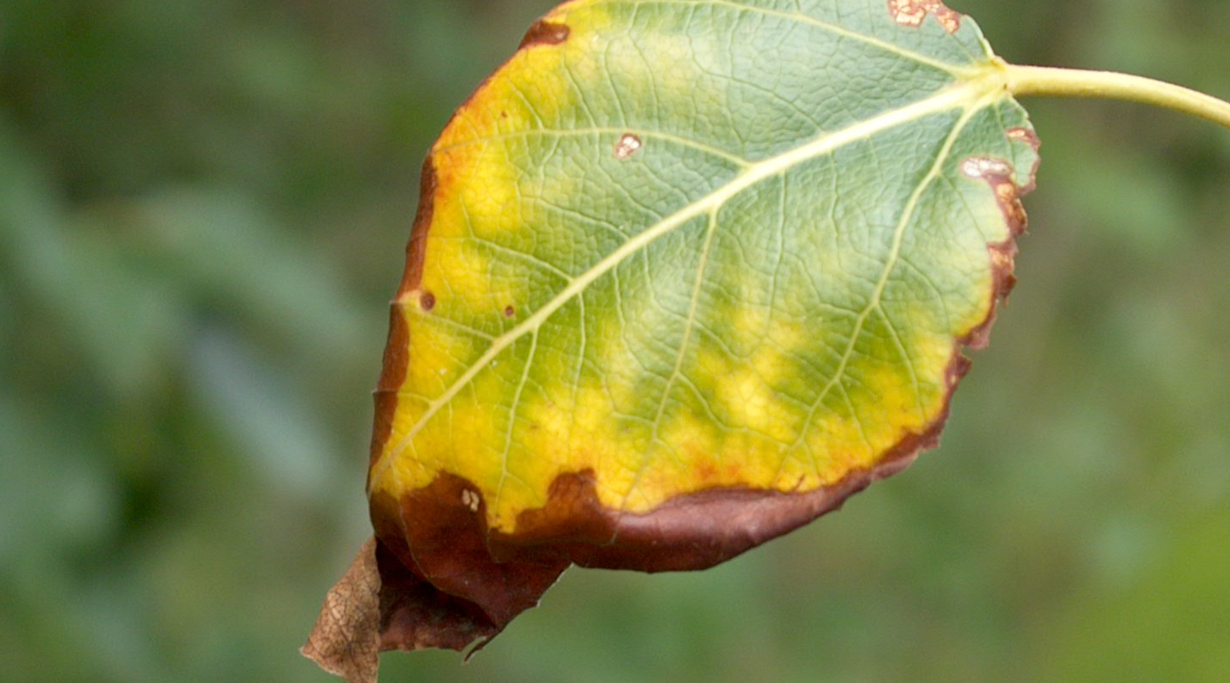


Climate Change & Forest Health
Alberta Invasive Species Council 2023
Mike Undershultz, Forest Health & Adaptation

Slide 2
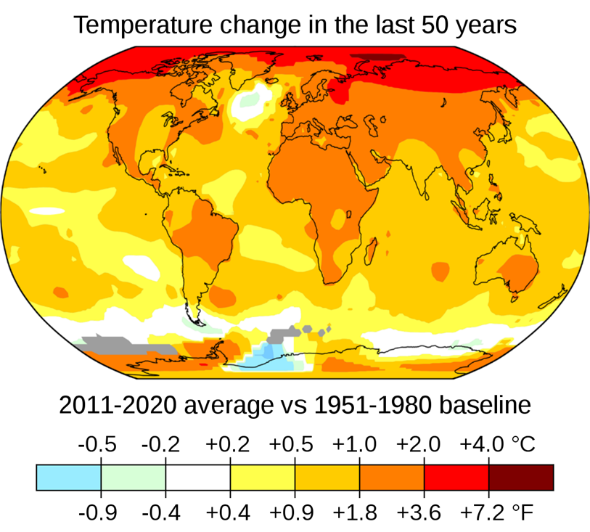
Notes:
Models predict most significant changes in northern hemisphere
In Canada, AB and prairie provinces predicted to have most change
Percip relatively similar but changes in timing
Moisture deficit predicted to be the most important factor influencing the health and productivity of Alberta’s forests.

Slide 3
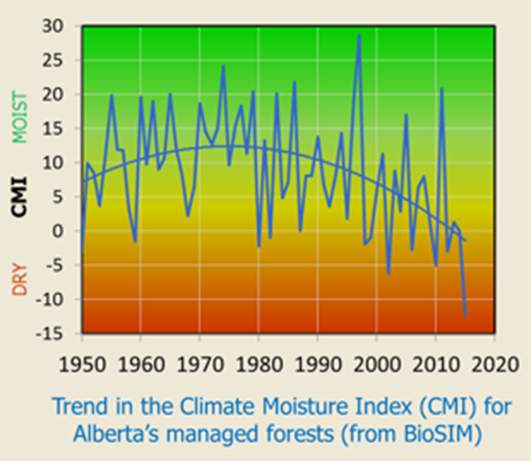
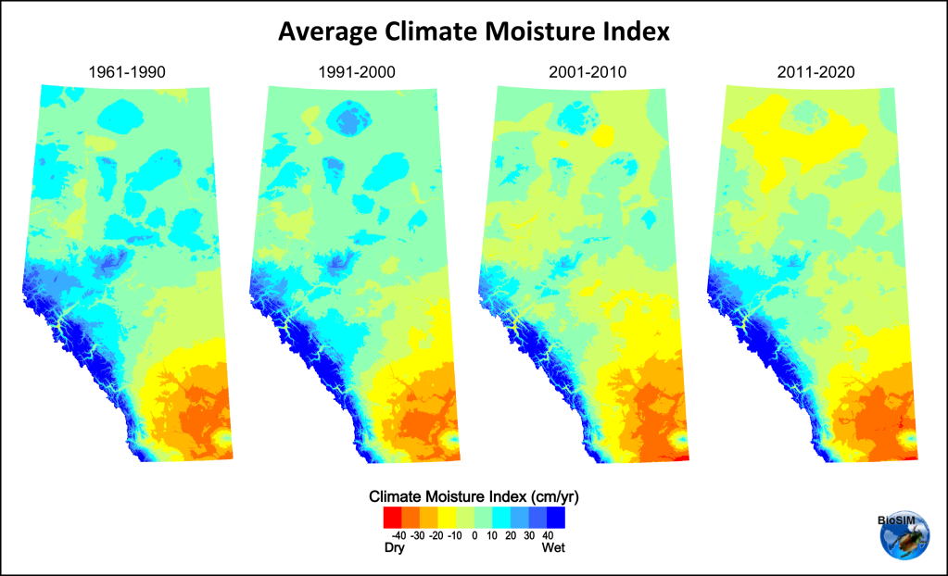
Climate moisture index
CMI = P − PET
P = mean annual precipitation (rain and snow)
PET = annual potential evapotranspiration from a well-vegetated landscape

Slide 4
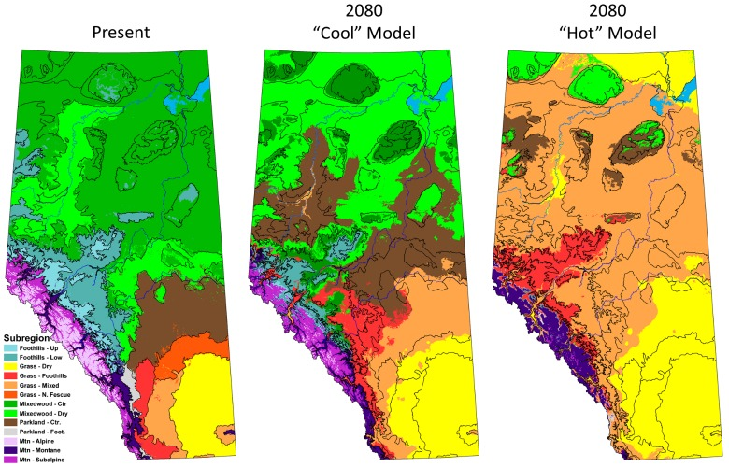
Alberta climate projections
Schneider, R. R. 2013
Notes:
Even using a conservative increase of 2°C over the next decade, Alberta’s bioclimate envelopes are projected to shift northward
The parkland forests of the Edmonton area will come to resemble the grassland landscape around Calgary
the “hot” climate model that predicts drier conditions and temperature increases of up to 6.5°C, predictions almost completely denude Alberta of areas suitable for boreal mixedwood forests.

Slide 5
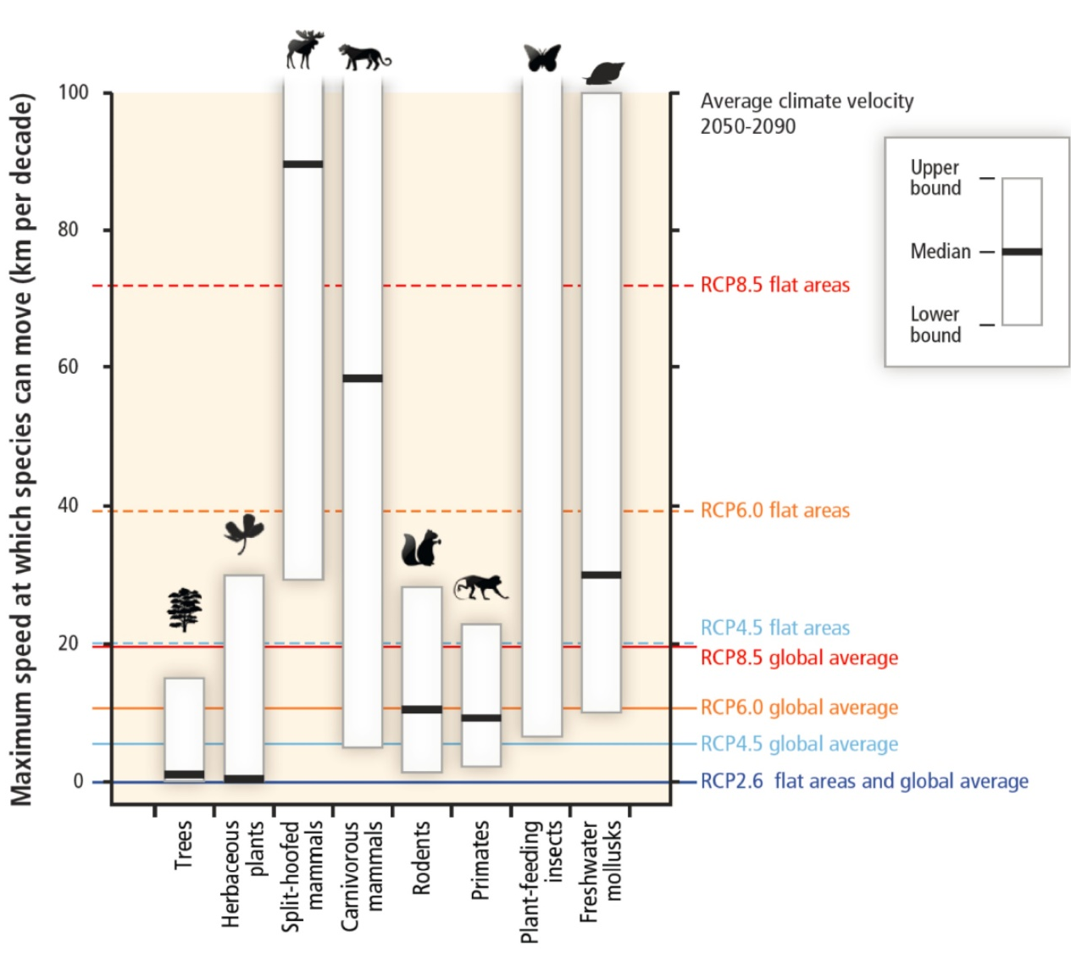
Species responses
Shifts of climatic envelopes are predicted to out pace any ability for vegetation to naturally adapt.

Slide 6
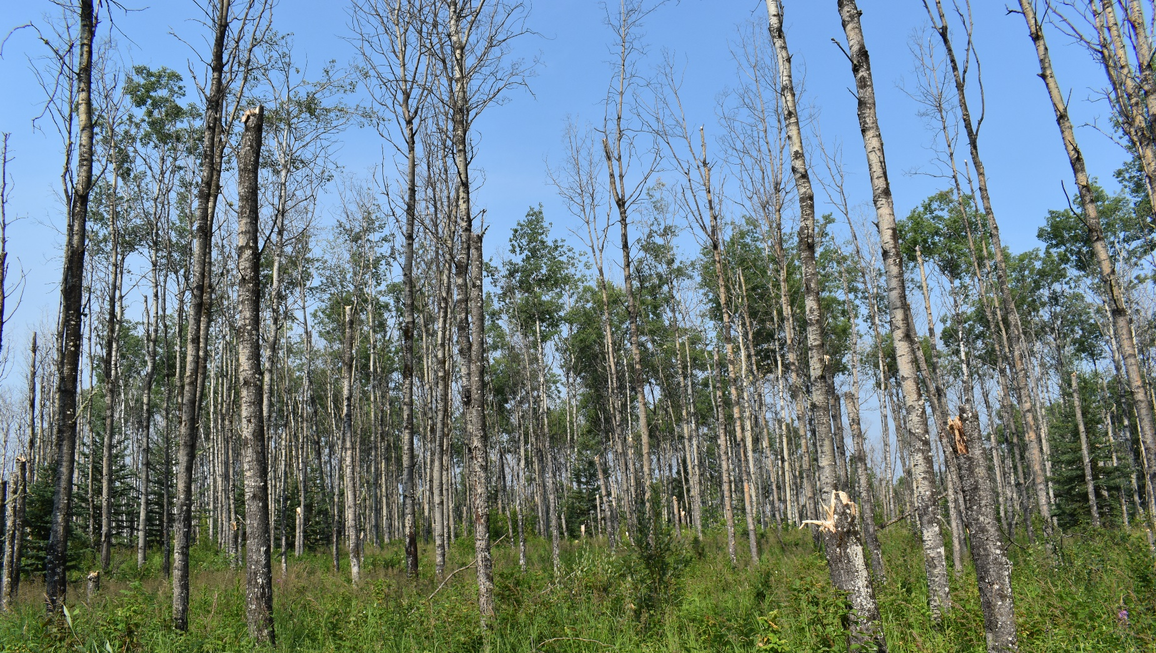
Forest Health Changes

Slide 7
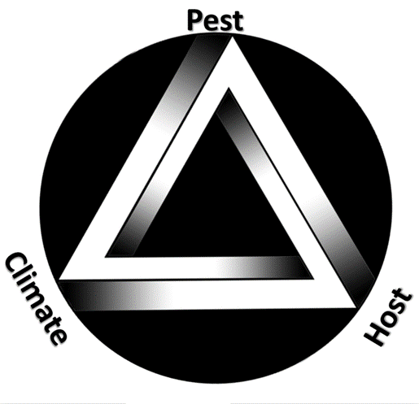
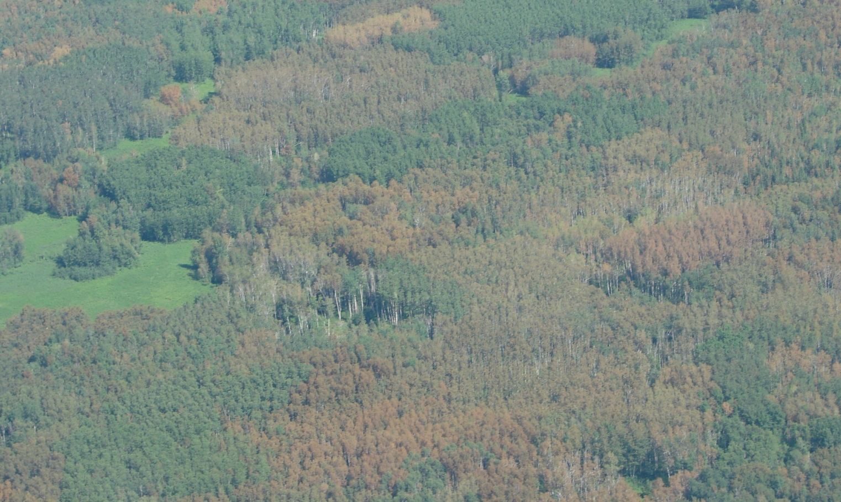
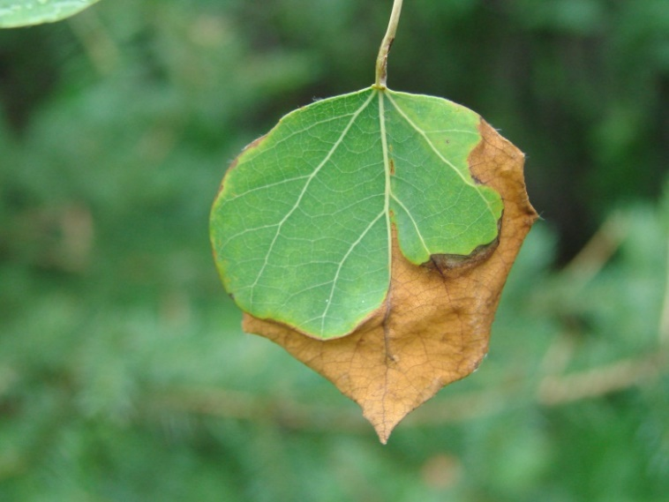
Drought
Notes:
Drought is example of weather impacting tree health.
Can kill trees if hard and long enough on own, but most often makes trees more susceptible to damage by other pests
Predicted to be one of the most important damaging agents

Slide 8
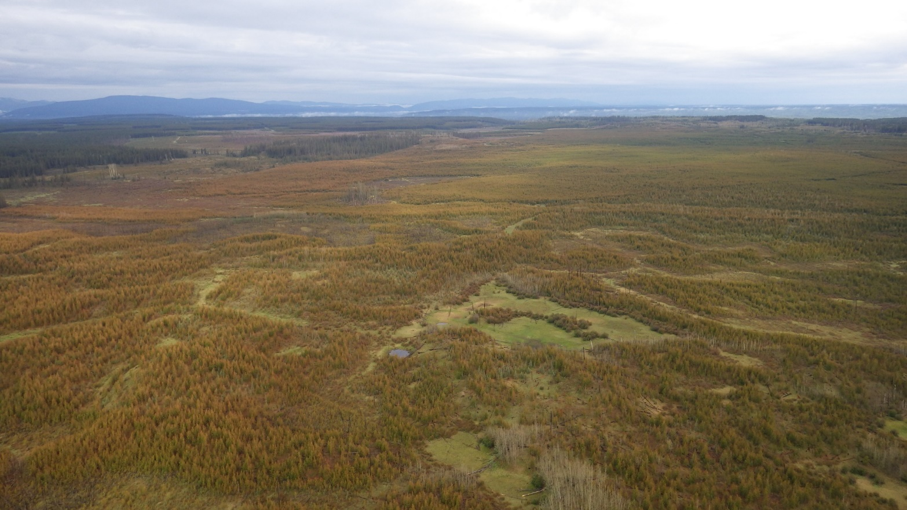
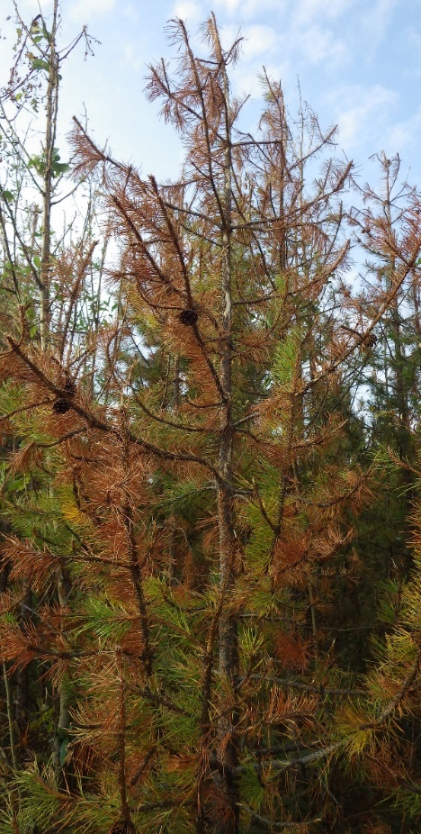
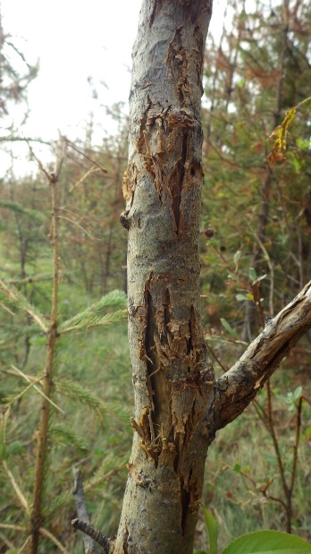
Hail
Notes:
Hail damage on regenerating block south of Hinton 20
Lots of wild/severe weather predicted

Slide 9
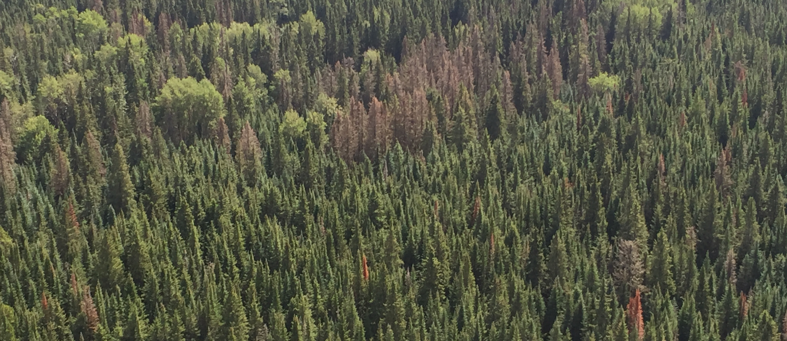
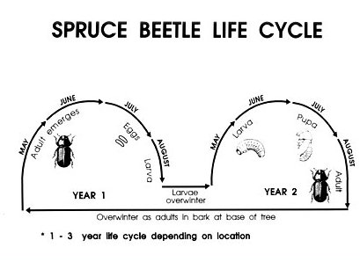
Bark beetles
Notes:
Changes in temperature and precipitation will affect life histories, dispersion, reproduction, and population dynamics of many forest pests.
Temperature impacting pest life cycles. Yukon example of SB switching to 1 year life cycle.

Slide 10
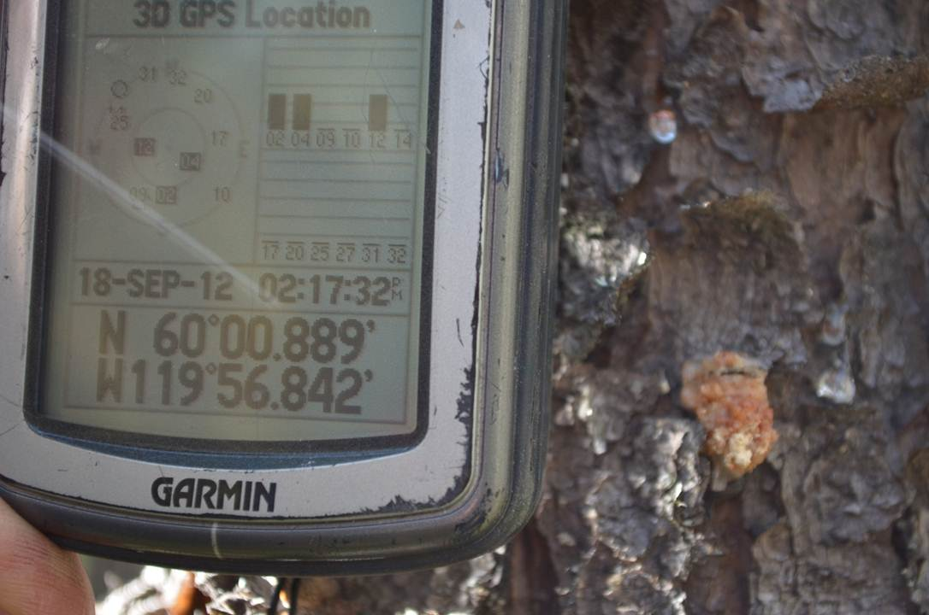
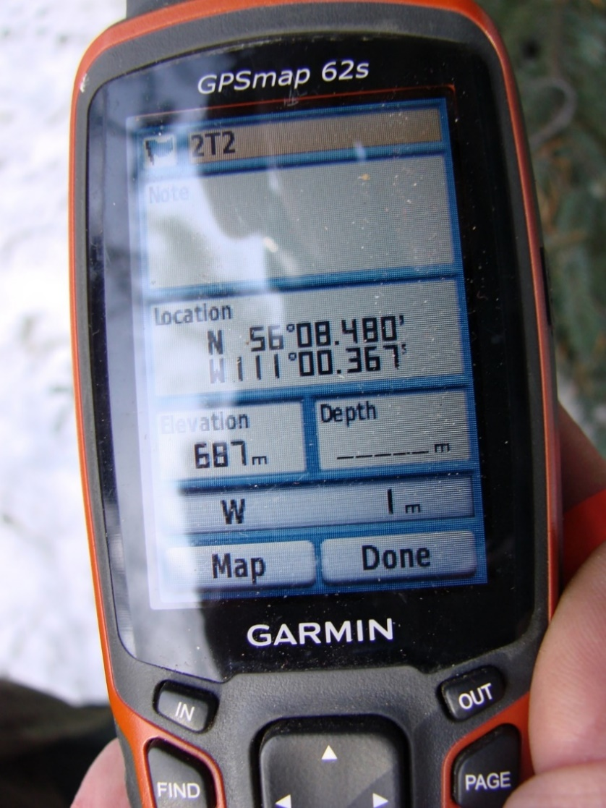
Notes:
MPB range expansion example of how temp and moisture thresholds can expand/contract pest range
Warm weather promotes insect development and mild winter reduces over-winter mortality
MPB currently north of 60, almost in SK and recently discovered near Pigeon Lake

Slide 11
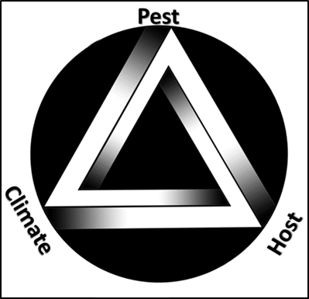
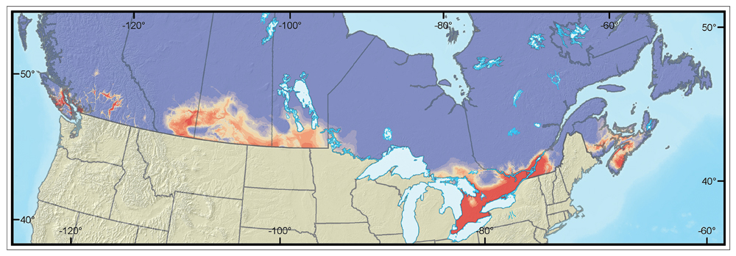
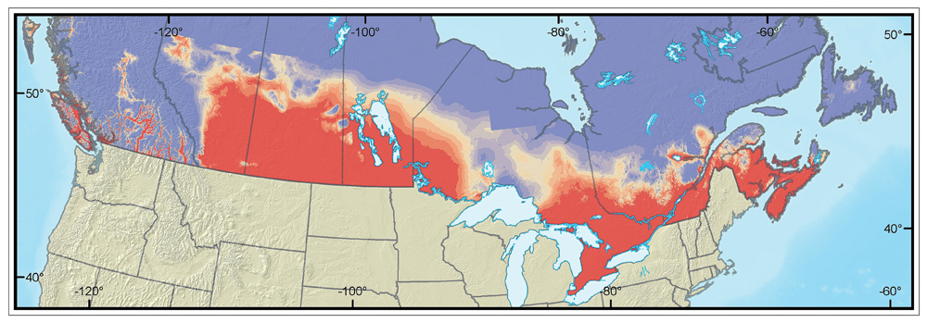
Spongy moth
Notes:
Gypsy moth habitat suitability changes
Cold weather not a limiting factor

Slide 12
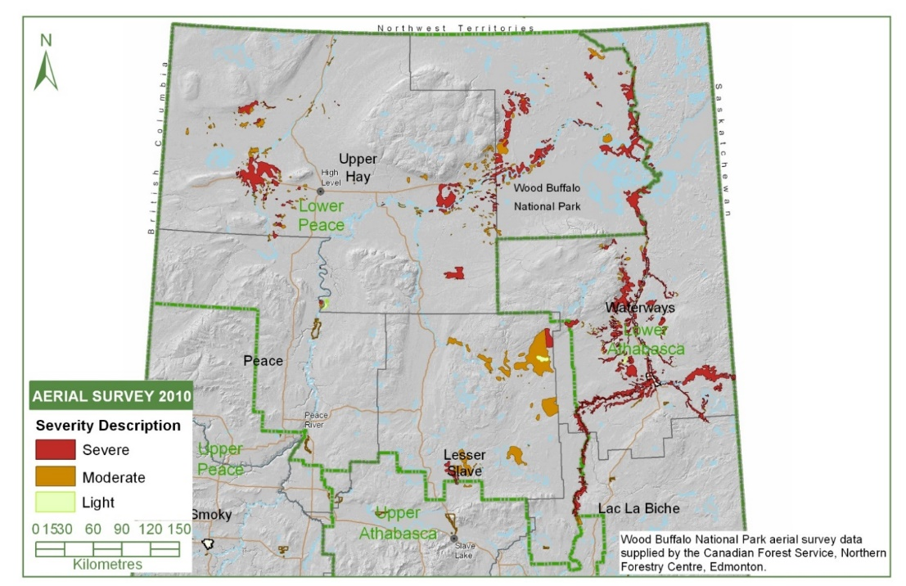
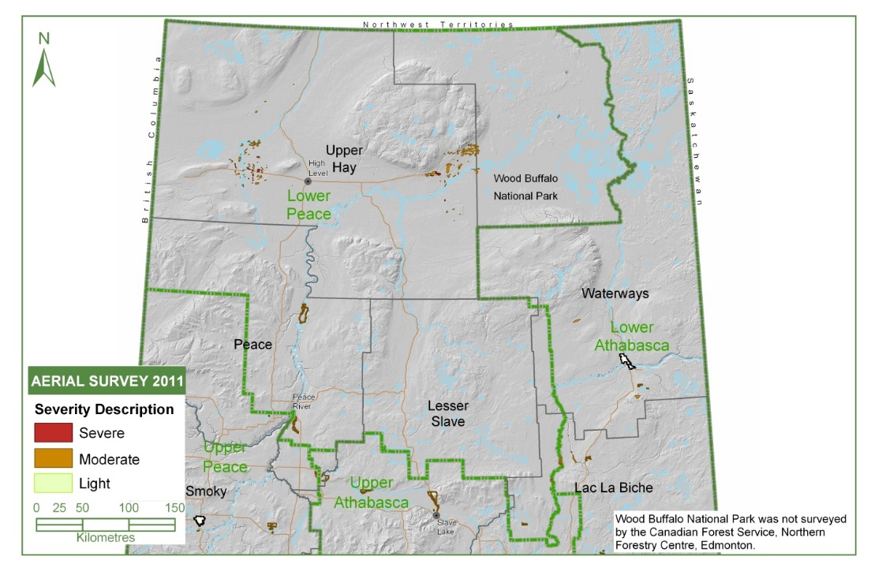
Spruce budworm
SBW Defoliated Area
2010 – 269,367 ha
2011 – 35,403 ha
Notes:
Precipitation during moth flight period disrupting pop growth. We speculate this was the cause of this change.

Slide 13
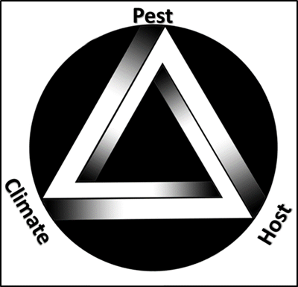
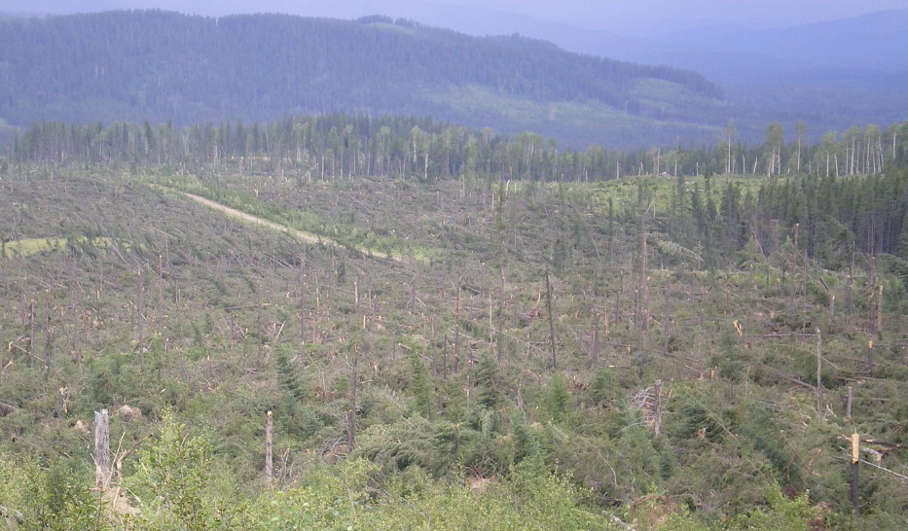
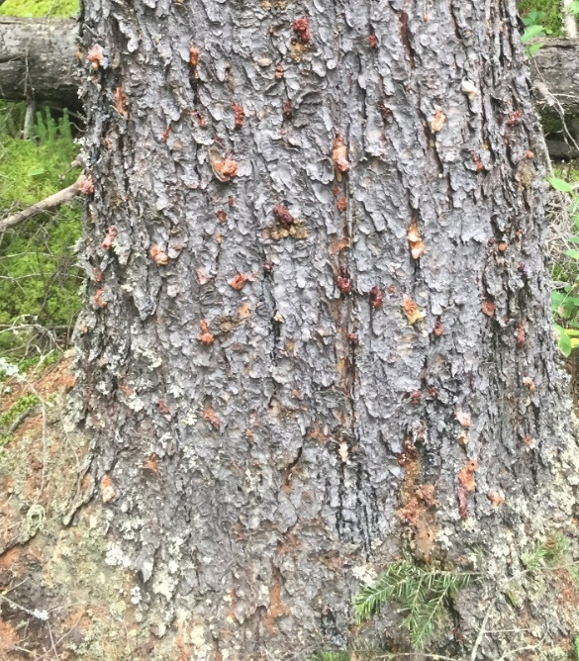
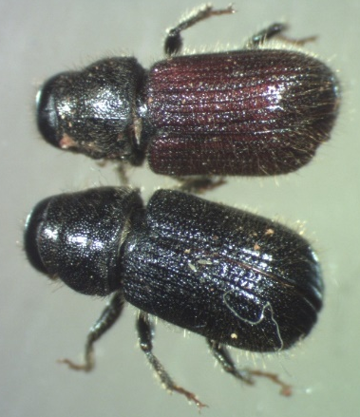
Spruce beetle
Notes:
Climate can help insect populations. E.g. blowdown potentially kicking off an infestation
Cited as one of the contributing factors that kicked off the current SB infestation in NE BC
BC 2017 annual report = 501,000ha impacted to some degree.

Slide 14
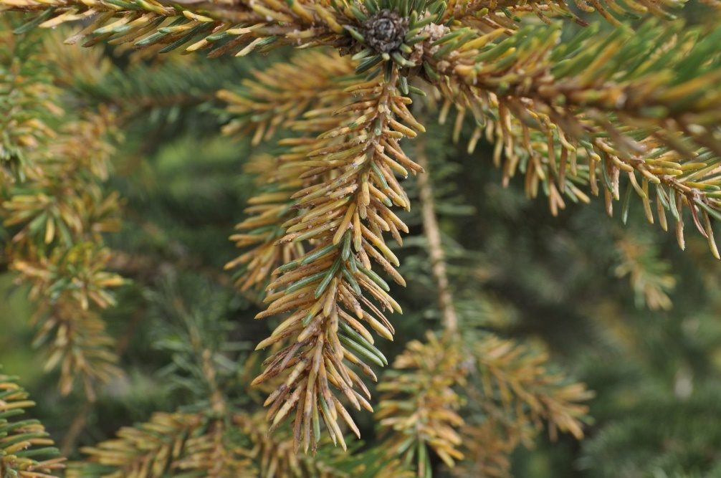
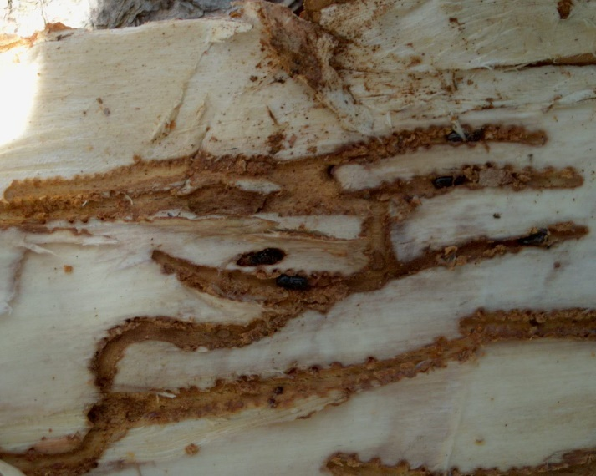
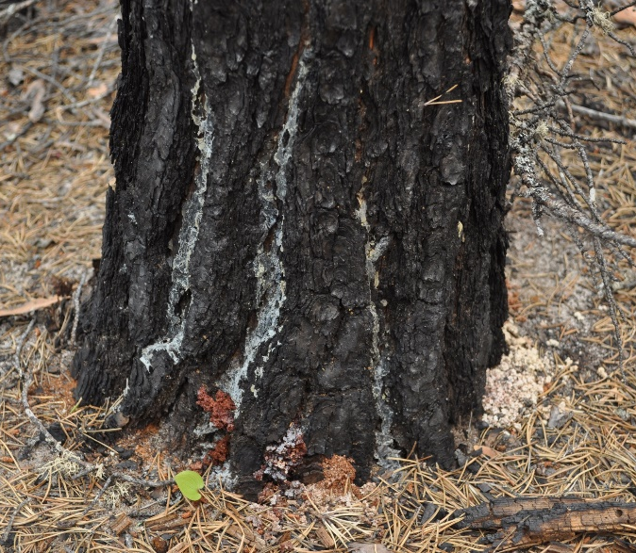
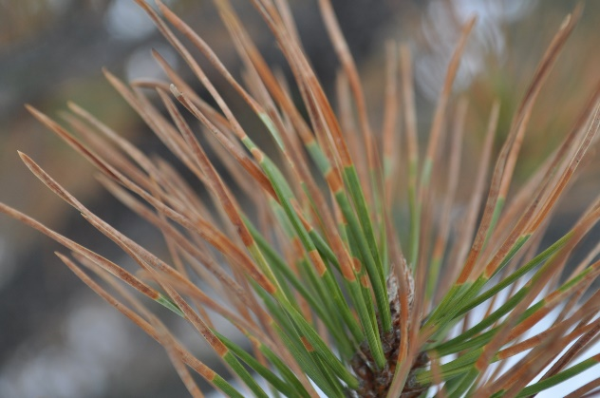
Minor pests behaving badly
Notes:
Resulting from either beneficial climate and/or increased tree stress
E.g. Ips, needle rust, red turpentine beetle, dothistroma

Slide 15

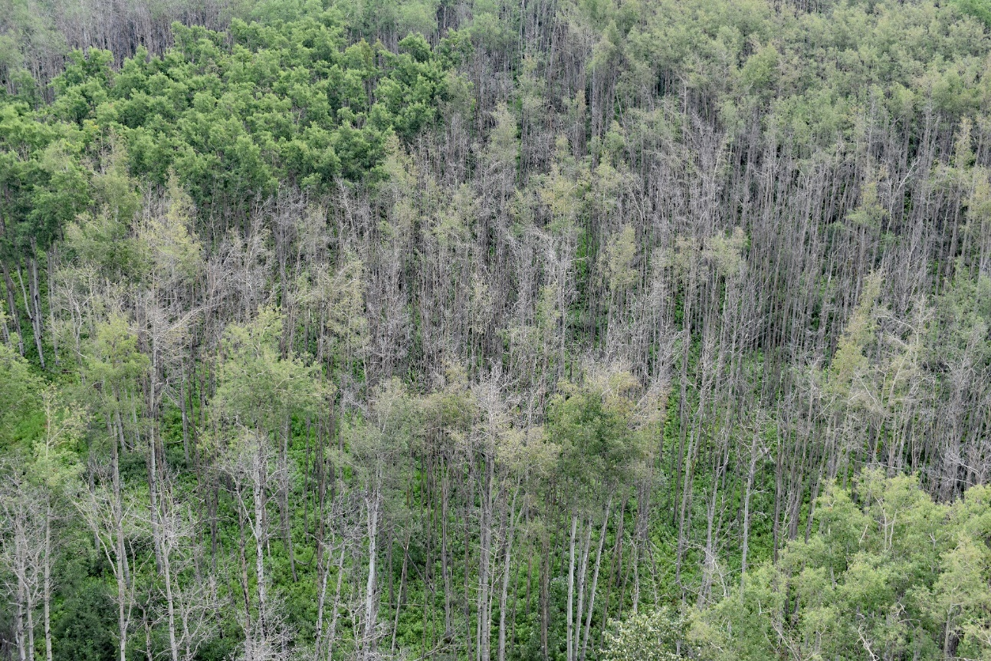
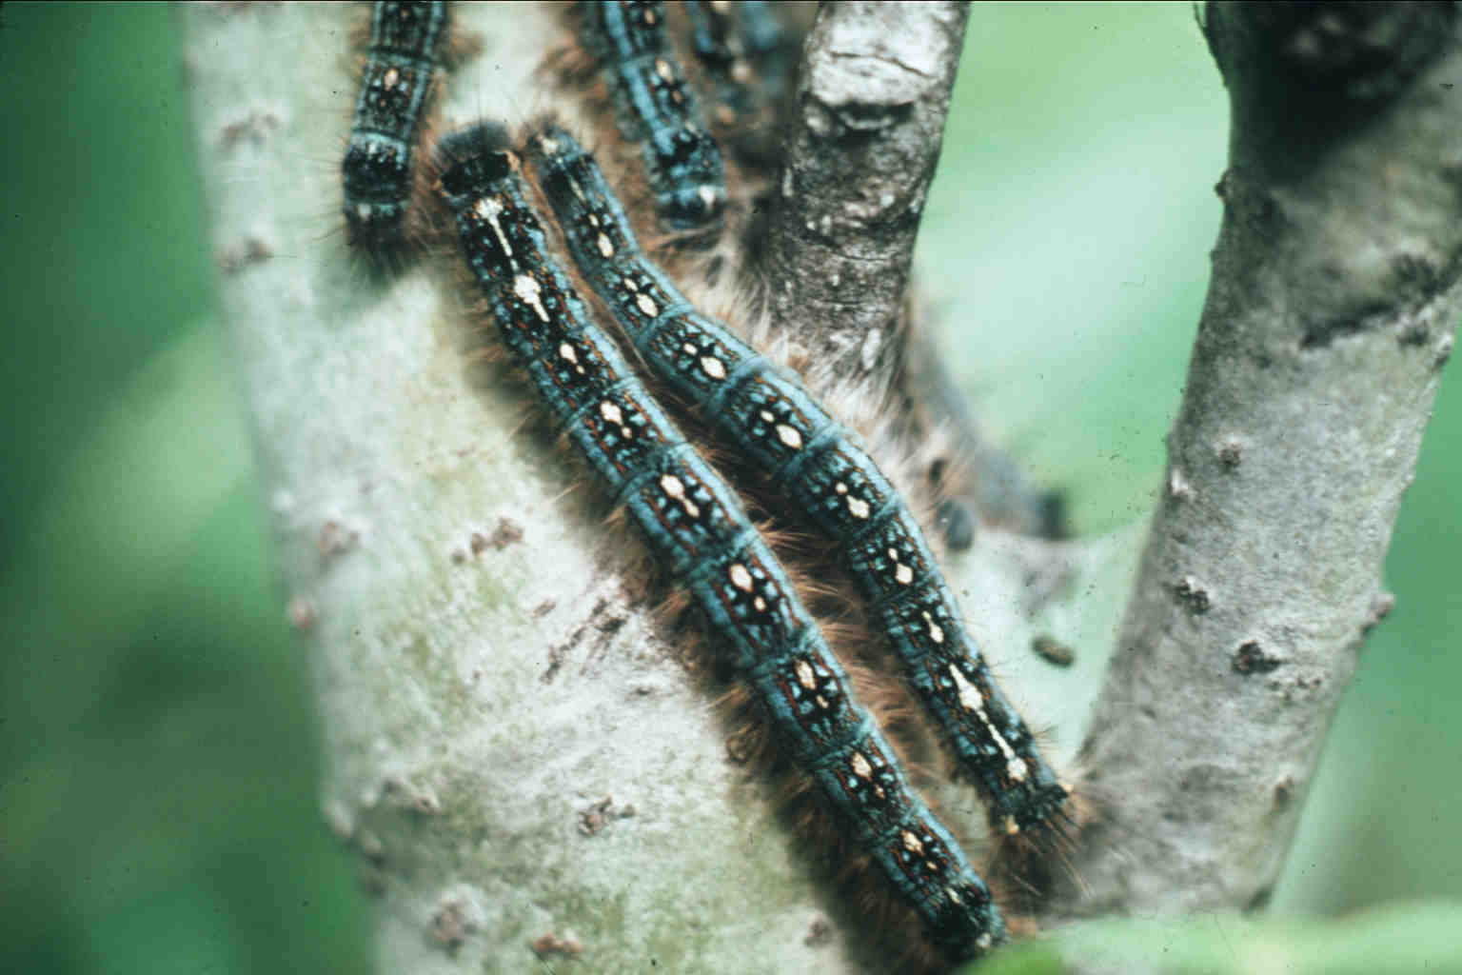
Combined impacts
Notes:
The result of defoliation and drought together is worse than the additive impacts of each stressor alone.
I will use this as a case study to examine potential damage

Slide 16
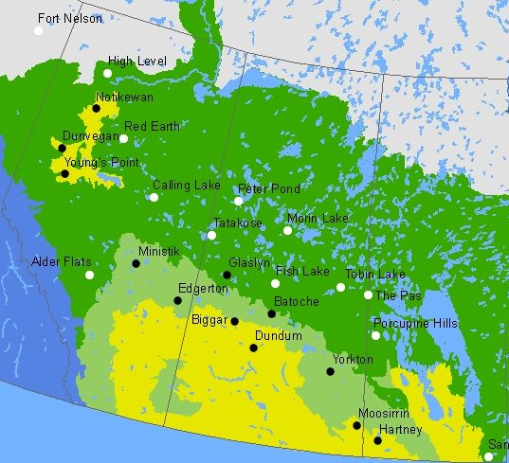
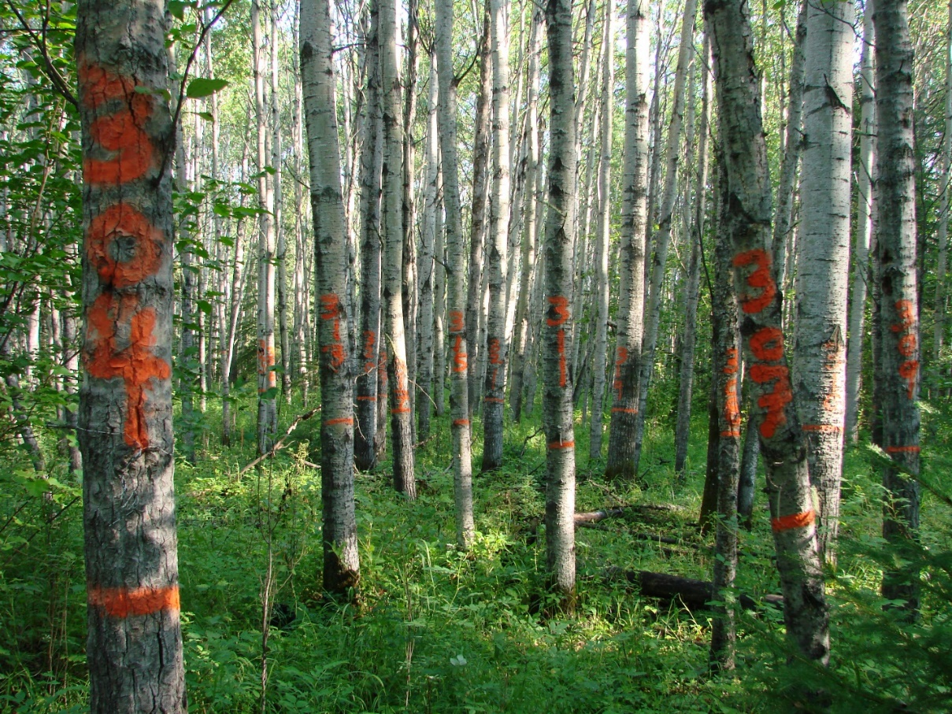
Climate Impacts on the Productivity and Health of Aspen (CIPHA)

Slide 17
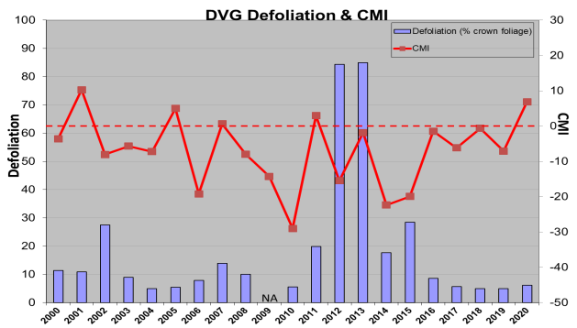

Slide 18
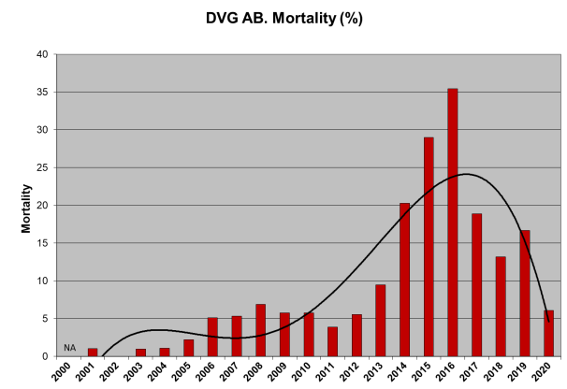

Slide 19
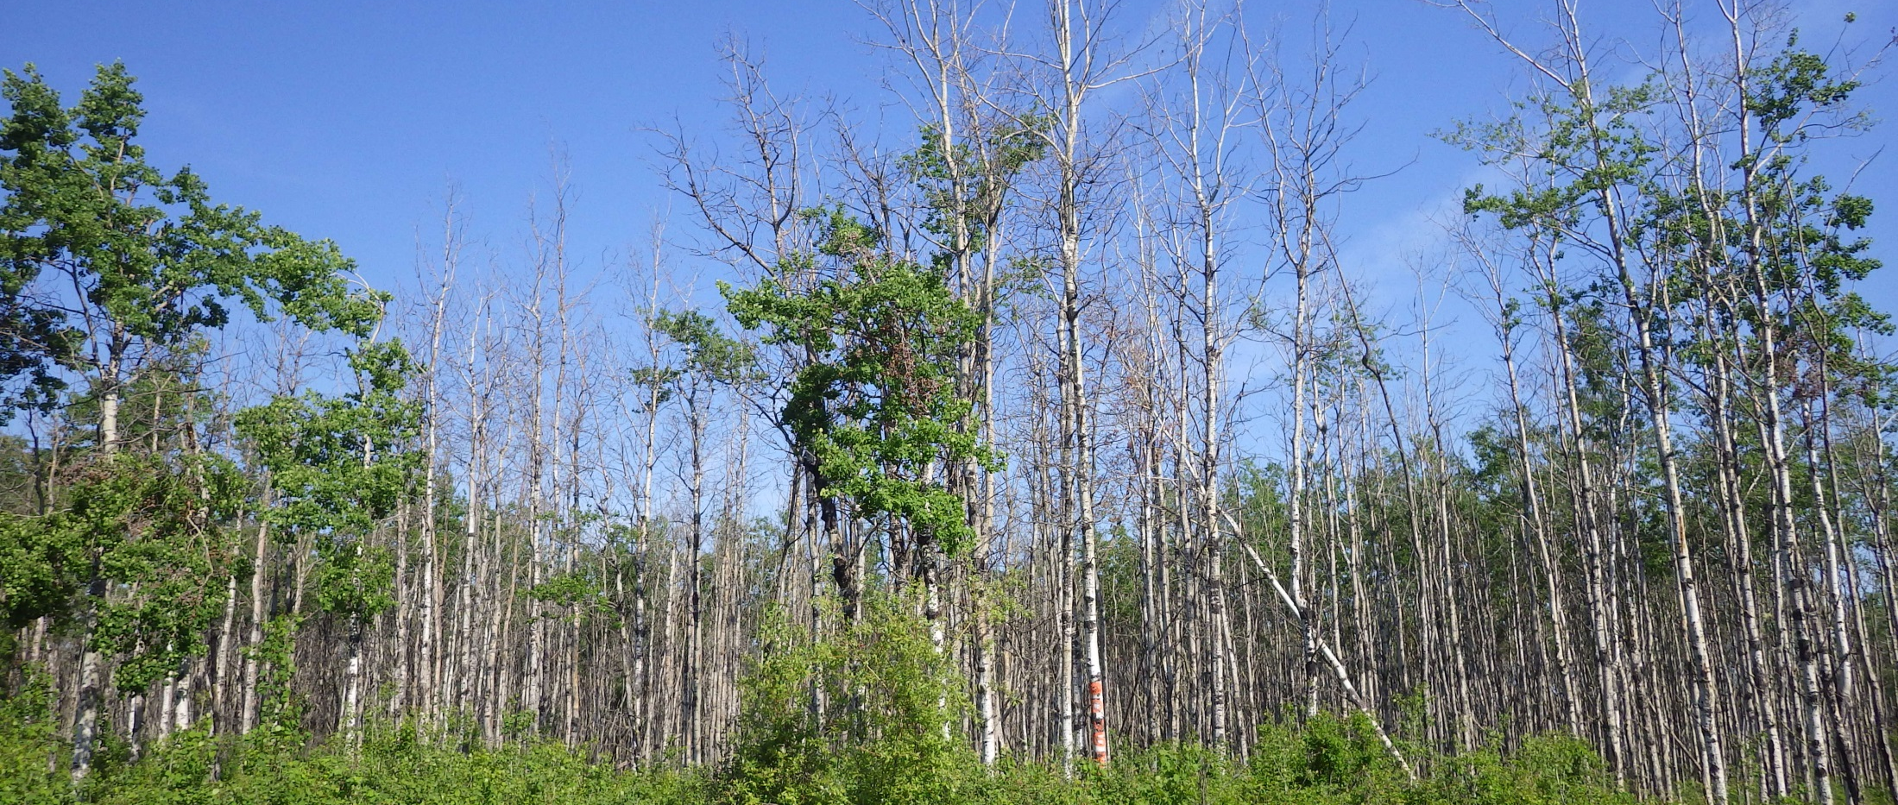
Notes:
Dunvegan CIPHA plot following mortality

Slide 20
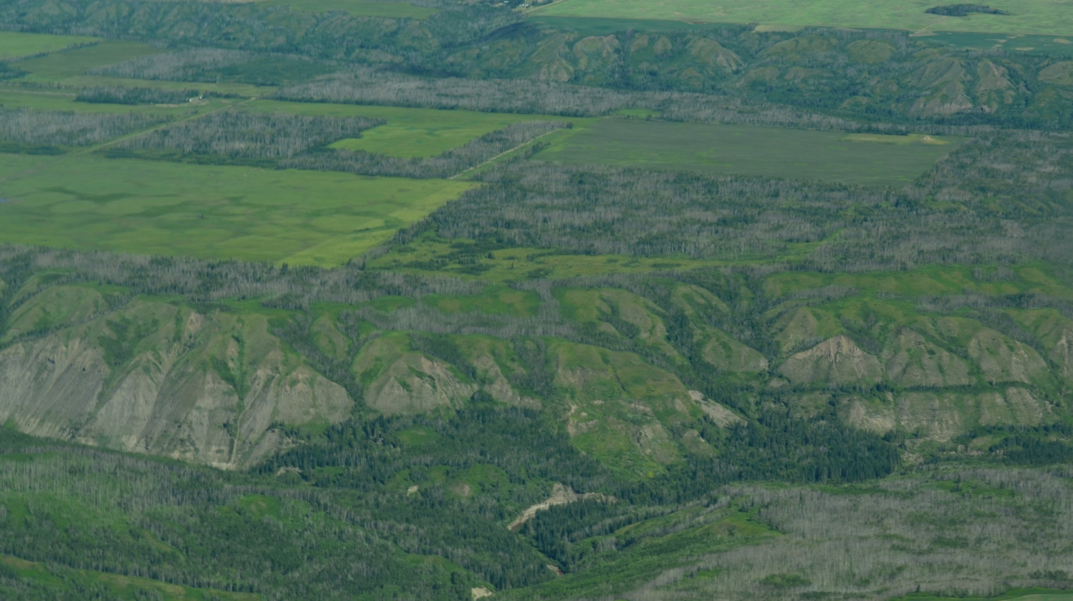
Notes:
Aspen mortality in area near Dunvegan

Slide 21

White spruce tree ring study
Summary of methods:
Increment cores collected from 75 pure white stands in AB and western SK (total of 400 trees)
Ring width measurements were used to reconstruct annual DBH and subsequently biomass
Examined relationship between decadal growth decline and climatic drying (1990s to 2000s)
Compared drought responses of younger (<100 year) versus older (>100 year) stands
Notes:
This study was precursor to CIPHS project.

Slide 22
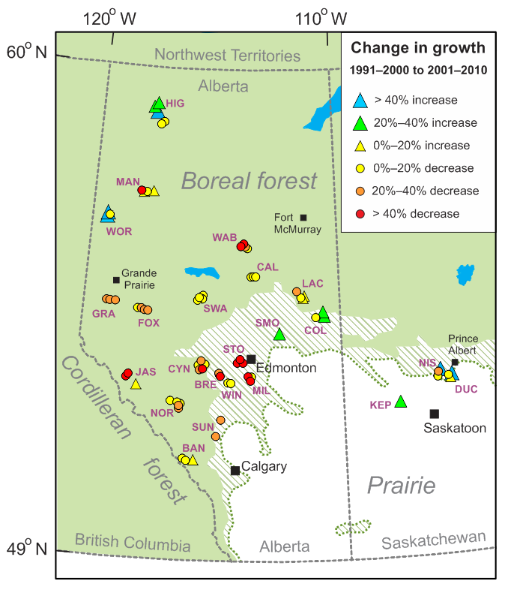
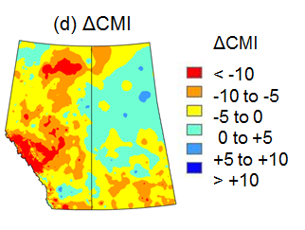
White spruce tree ring study
Recent climatic drying leads to age-independent growth reductions of white spruce stands in western Canada
Global Change Biology 2017;23:5297-5308.
(T. Hogg et al)
Notes:
Notice how plots with large decreases in growth are somewhat in line with areas where change in CMI between decades was the largest

Slide 23
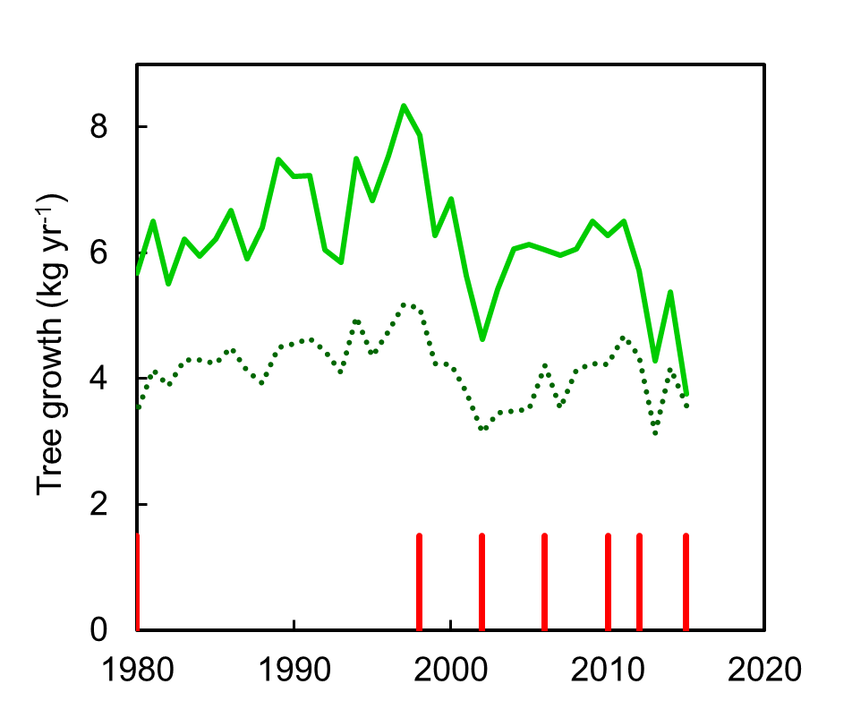
White spruce tree ring study
Young stands
Old stands
Severe droughts
Notes:
Results show that this climatic impact is affecting both younger and older trees.

Slide 24
Climate Change Adaptation

Slide 25
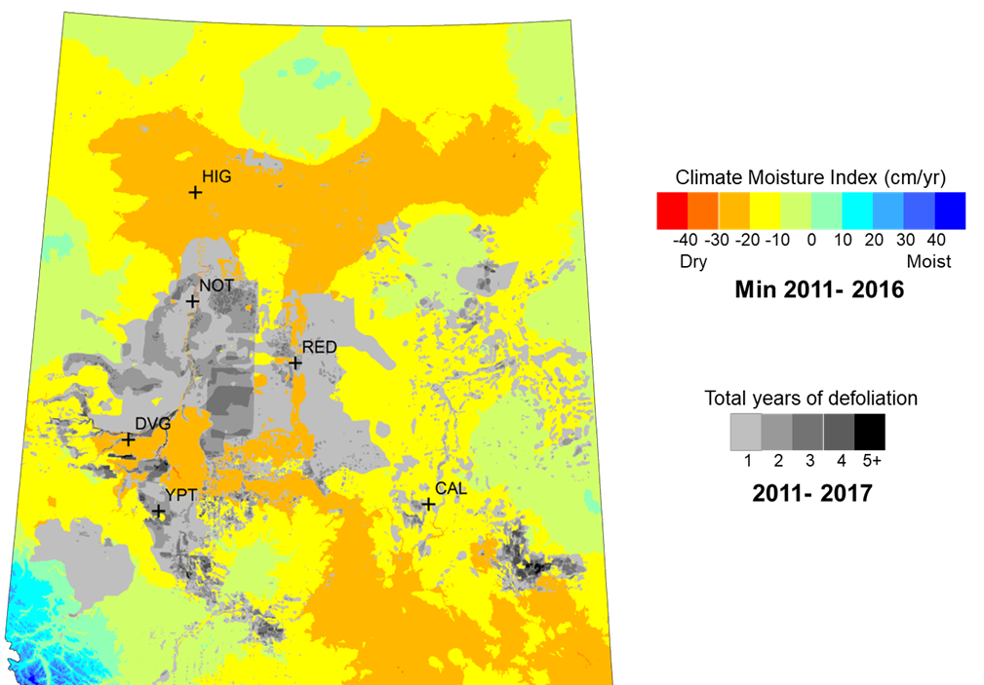
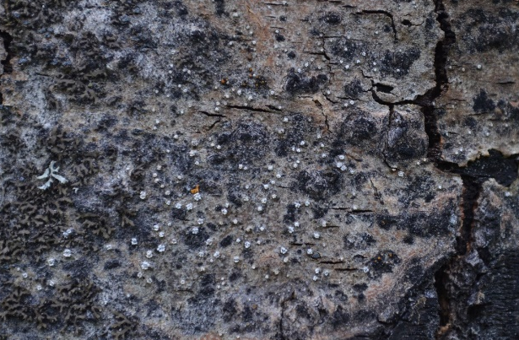
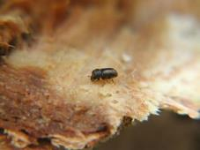
Aspen Mortality Risk Tool
Notes:
Aspen mortality risk tool currently in final stages of development (as of May 2021)
Step 1 - Uses defol and drought to identify stands at risk
Step 2 – quick and dirty ground based stand assessment of “marker” species characteristic of declining stands (cytospora canker and ambrosia beetle)

Slide 26
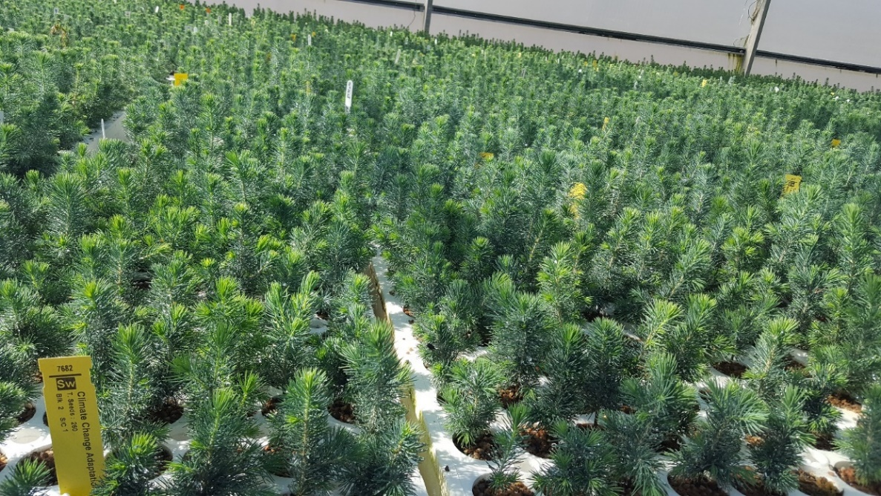
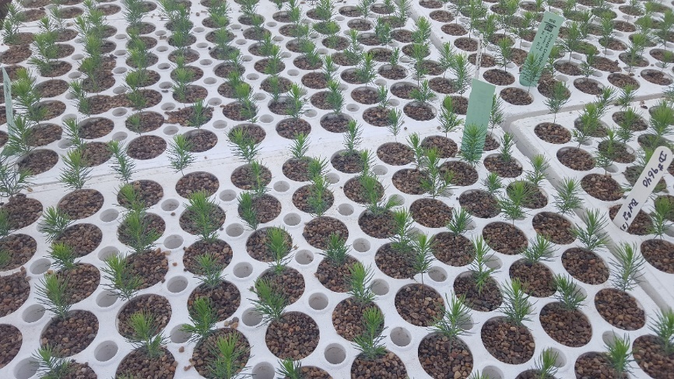
Climate-based Seed Transfer
Exploitation of population genetic variation in selection and use of seed sources (provenances/populations) for climate change adaptation.

Slide 27
Climate-based Seed transfer
Transfer of seed among tree breeding regions for white spruce in Alberta
RED –transfer reduce growth in the target region
GREEN –transfer increase growth in the target region

Slide 28
Successful mgmt. of forests in a changing climate will require:
Improve detection of FH damage agents
Long-term monitoring of forest productivity and pest impacts in relation to climate
Tree improvement, assisted migration and enhanced silviculture
Hedge your bets to strive for diversity in age-class, species composition and density – resilient forests.
Regional vulnerability assessments
Notes:
Improve detection of FH damage agents
including abiotic damage agents / early detection of invasive pests
all eyes trained to be on the look-out
Long-term monitoring of forest productivity and pest impacts in relation to climate
Coordinated and more in-depth PSP assessments
CIPHA/CIPHS
Tree improvement and assisted migration
Pest/drought resistant tree breeding and assisted tree migration
Hedge your bets to strive for diversity in age-class, species composition and density
Monitor non-commercial tree species (early warning)

Slide 29
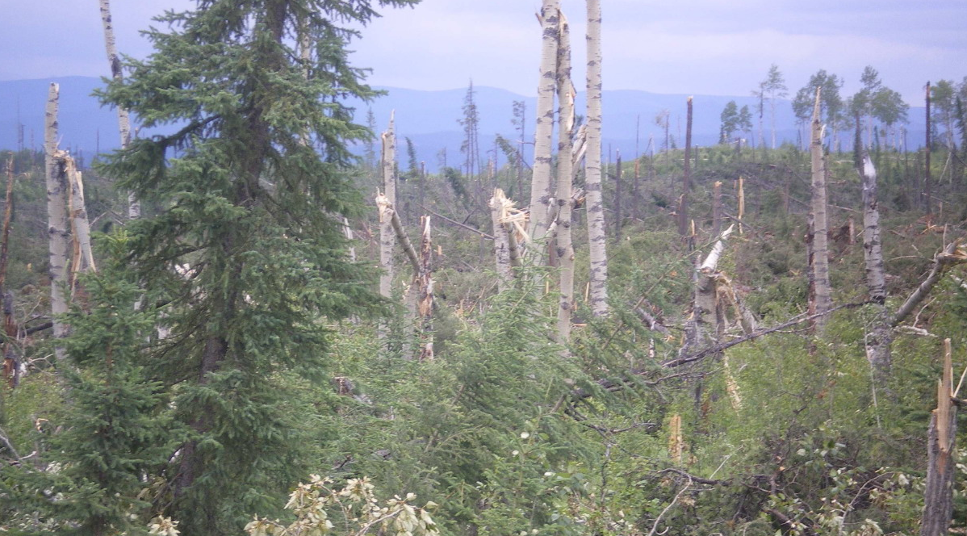
Questions?

